Slide 1
Buddy - Your friend in need
The tool to help each other, serving mankind

Slide 2
Overview
On average, the U.S. wastes an estimated 125 to 160 billion pounds of food each year. And where does it all end up? In a landfill, where it’s buried under mounds of toxic trash and eventually breaks down and emits methane. We bury so much organic waste that landfills are now the third-largest source of climate-damaging methane emissions in the U.S.
Buddy comes here with a solution, it connects with restaurants, stores, medical shops and individual donors to connect with your needy friend. We are here to solve economic crisis, environmental hazards and hunger among our people.

Slide 3
How we do this?
01
We want to create software that connects food/grocery/medical establishments with volunteers who can direct possible waste input to people in need via delivery men and distributors.
02
We also have a system in place for dropping off food to adjacent supermarkets so that food can be distributed across different regions.
03
To end world hunger, this strategy can be scaled up to different countries.

Slide 4
What’s extra in here?
Email Confirmation on Registration
Real time SMS updates

Slide 5
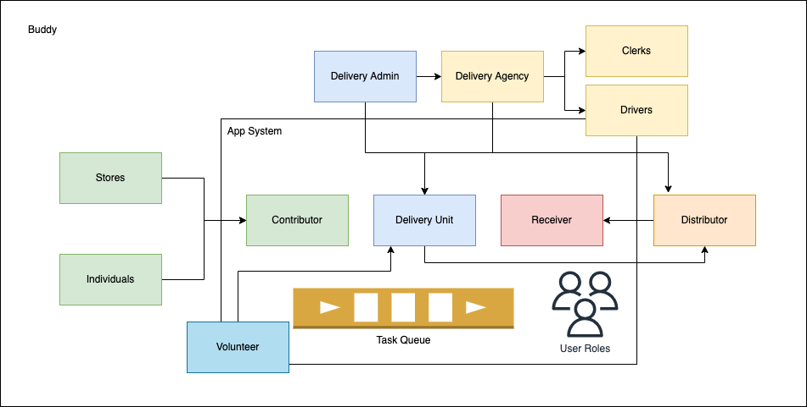



Architecture

Slide 6
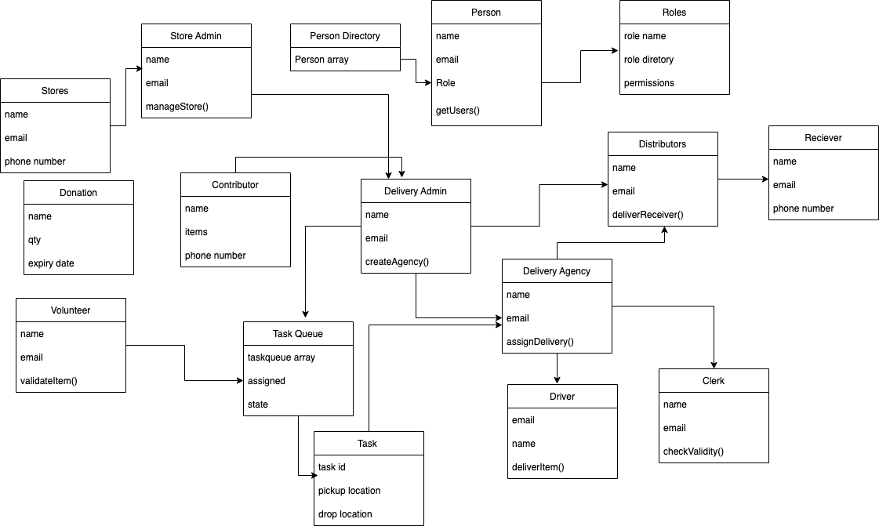
UML Diagram

Slide 7
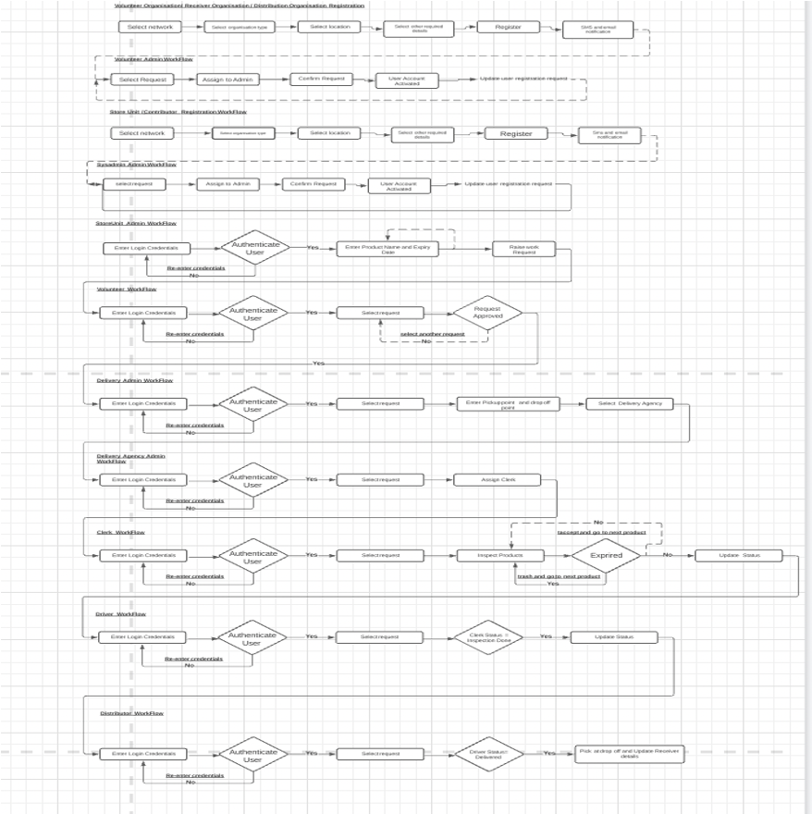
WorkFlow

Slide 8
Enterprises
Store Unit (Restaurants/ Medical/ Grocery Stores)
Delivery Unit
Distributors
Volunteer Units
Contributor Unit
Receiver Unit

Slide 9
Organizations
Store Organization
Contributor Organization
Volunteer Organization
Delivery Admin Organization
Delivery Agency Organization
Clerks Organization
Drivers Organization
Distributor Organization
Receiver Organization

Slide 10
Roles and Contributions
Contributor
Contributor is an individual who can register on the portal , and raise for a request to donate the food, upon approval from the volunteer – selected delivery agent picks up the food at his location and delivers it to the distributor
Store Admin
Store admin is an admin of the store, who raises the request to donate the products from the store mentioning their expiry dates,, which upon approval from the volunteer – the selected delivery agent picks up from the store location and delivers it to the distributor .

Slide 11
Roles and Contributions
Volunteer
Volunteer is one of the representatives of the Non-Profit organization, who essentially takes care of the requests received from the various stores and individual contributors and approves the raised requests based on the requirement and sends it forward in the pipeline to the delivery admin.
Delivery Admin
Delivery Admin role is part of the Non-Profit Organization, who receives the approved requests from the volunteer and co-ordinates the pickup and drop-off location of the donation with various delivery agencies based on their availability

Slide 12
Roles and Contributions
Delivery Agency Admin
Delivery Agency admin is the main administrator of the delivery agency (Fleet Management Enterprise), who receives the request from the Delivery Admin and assigns a clerk and a driver for the request. Delivery Agency Admin completely manages the agency’s clerks and drivers.
Driver
Driver is part of the delivery agency enterprise, who receives the request from the agency admin, and based on the pickup and drop off location of the he organizes his route with the help of the map feature in the application.

Slide 13
Roles and Contributions
Clerk
Clerk is also a part of the delivery agency, who when receives the request from the agency admin , accompanies the driver to the pickup location and examines the expiry date of the product and loads them into the truck, and will update the status of the request in the app as “Inspection Done” or “Inspection in Process” etc. and forwards the request to the driver
Distributor
Distributor is one of the roles in the Volunteer Enterprise, who majorly deals with the last mile of the process by coordinating with the delivery agency on the status of the request and when collects the load when delivered at the drop-off location and connects it with the end receivers.

Slide 14
Roles and Contributions
Receiver
The end user/stakeholder of the load that the distributor has received is referred to as the receiver. It could be anyone who benefits from this food donation service, from people to sub distributors to college students, and so on.
Sys Admin
The top admin of the entire ecosystem, the sysadmin, is in charge of all work requests, roles, enterprises, and organizations.

Slide 15

Thank you!
Naina Rajan - 002922398
Thomas John - 002933800

